Slide 1
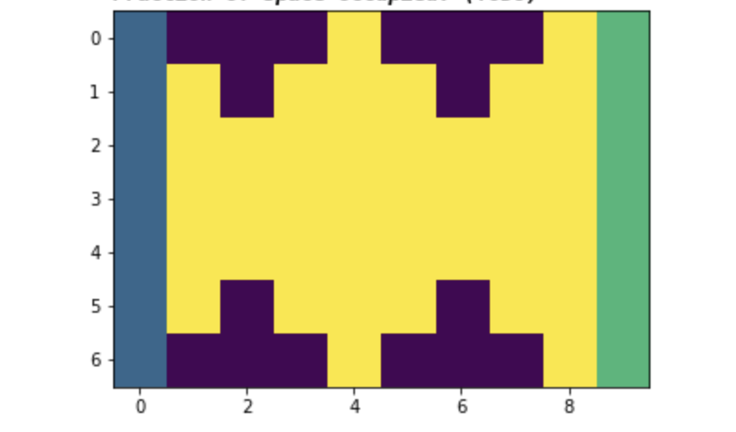
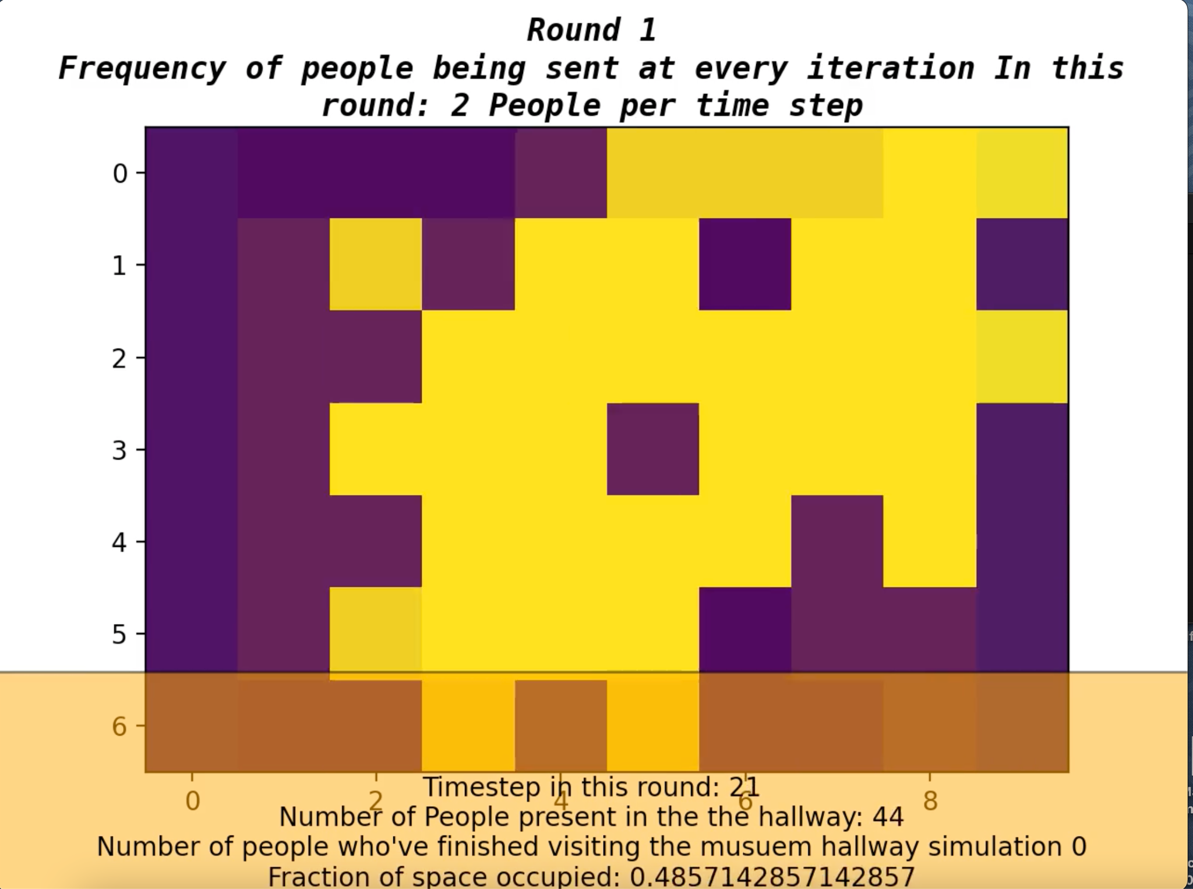
Preventing Crowd Crush: Simulating Movements within a Multi-Exhibit Museum Hallway
Maryam Azmandian
EPS 109 Final Project Presentation, Fall 2022
Notes:
a) a slide with the title, your name, and a large, descriptive still image.

Slide 2
Background
Some of us might be familiar with the concept of occupancy limits in different campus buildings and rooms. It’s absolutely crucial to note and abide by such regulations for our safety.
According to AlJazeera news, Crowd crush is a potentially catastrophic phenomenon in which a body of people in a confined space becomes dangerously overcrowded, causing the crowd to fall in a “domino effect” making it hard for people to get up again.
Unfortunately, such tragic events are not that rare. One of the most recent incidents took place in Itaewon, South Korea, where more than 150 precious lives were lost.
Notes:
b) a second slide that explains the topic of your simulation and the methods used.

Slide 3
Goals and Methods Used
In this simulation, we simulate a museum hallway with 4 exhibits through which people enter at a specific frequency (n people per timestep) and explore the exhibits, proceeding through the hallway until they exit. Throughout the simulation, we’ll track number of visitors present, fraction of occupied hallway, and recognize moments where a potential crowd crush incident occurs.
Visitor’s movement at each round will be affected and weighed by:
The strength/alignment of their interest in each exhibit → vector modeling of interests in genres using dot product
Time spent in the exhibit → logistic growth model
Available surrounding space
exit
entrance

Slide 4
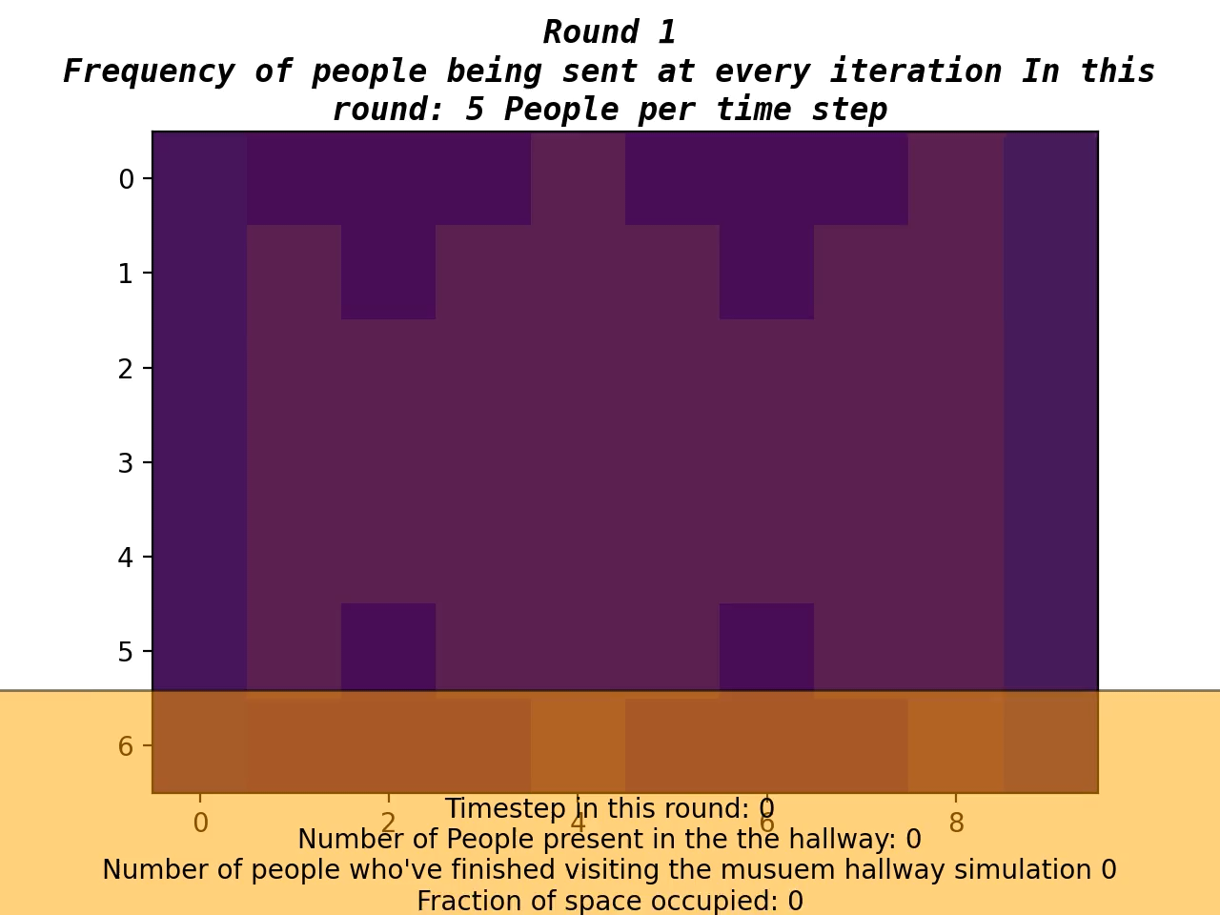
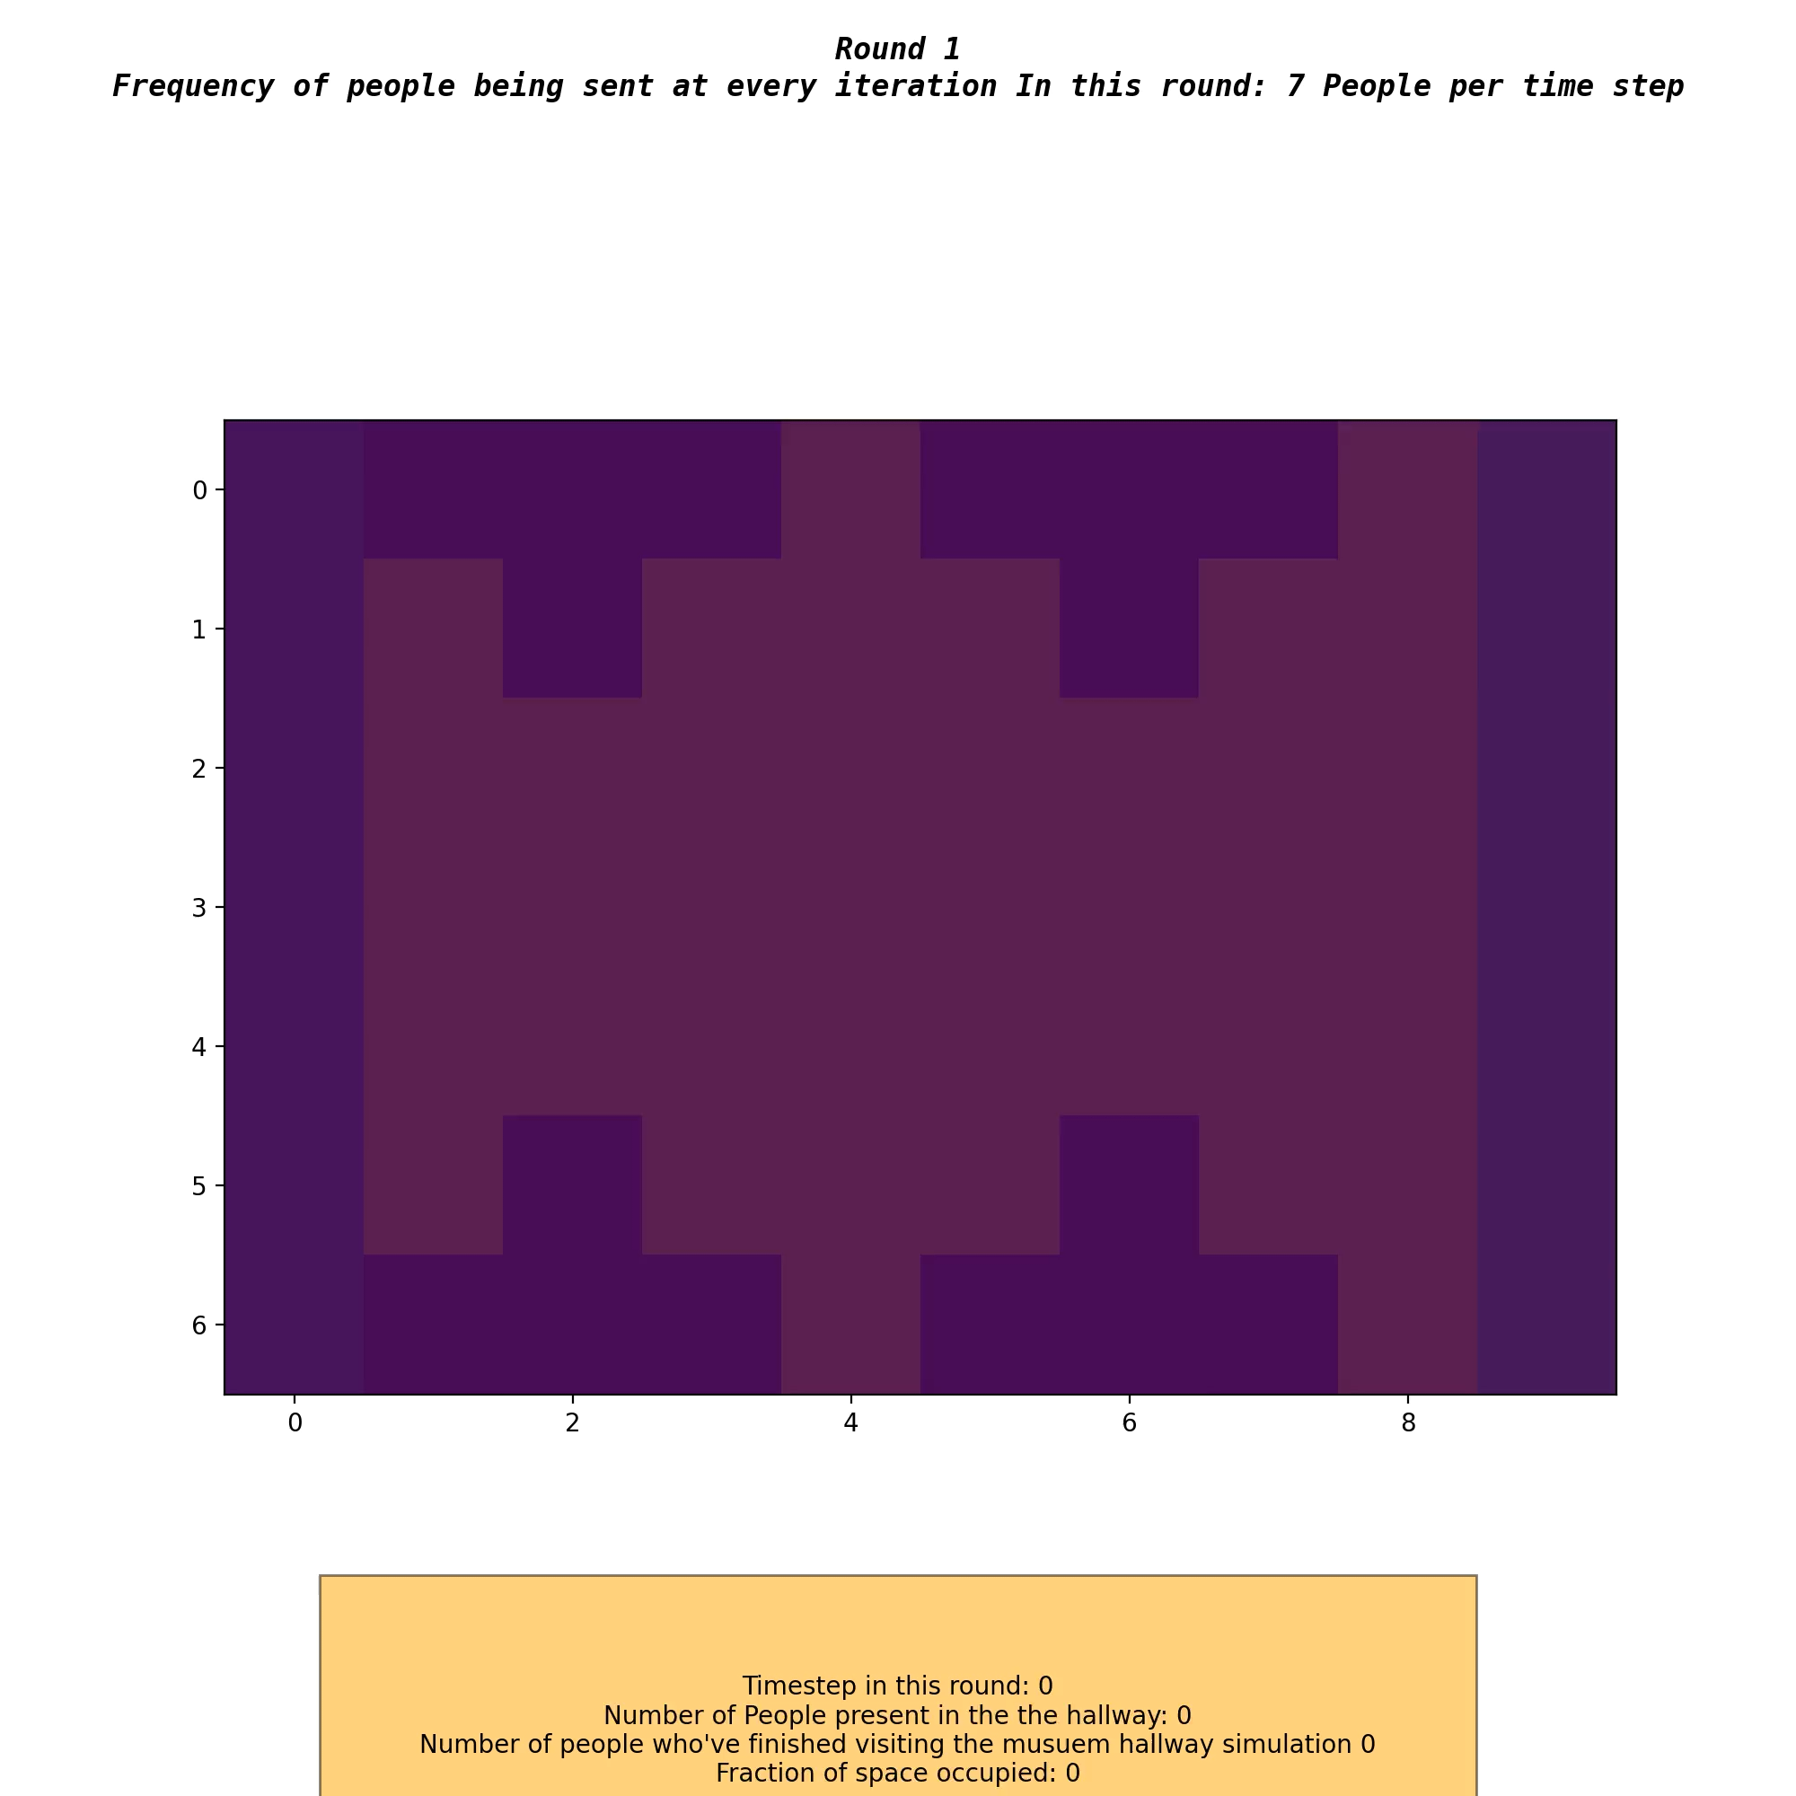

A few Simulations with different frequencies
Notes:
ormats, embedded directly in the PPTX file, and preferably start automatically when you switch to slide 3. On a Mac, you can achieve this in following way:

Slide 5
Preventing Crowd Crush: Simulating Movements within a Multi-Exhibit Museum Hallway
Thank you for your time!
Stay safe out there!
We now welcome any questions!
Notes:
a) a slide with the title, your name, and a large, descriptive still image.

